Slide 1

Meeting Slides
02/10/2021

Slide 2
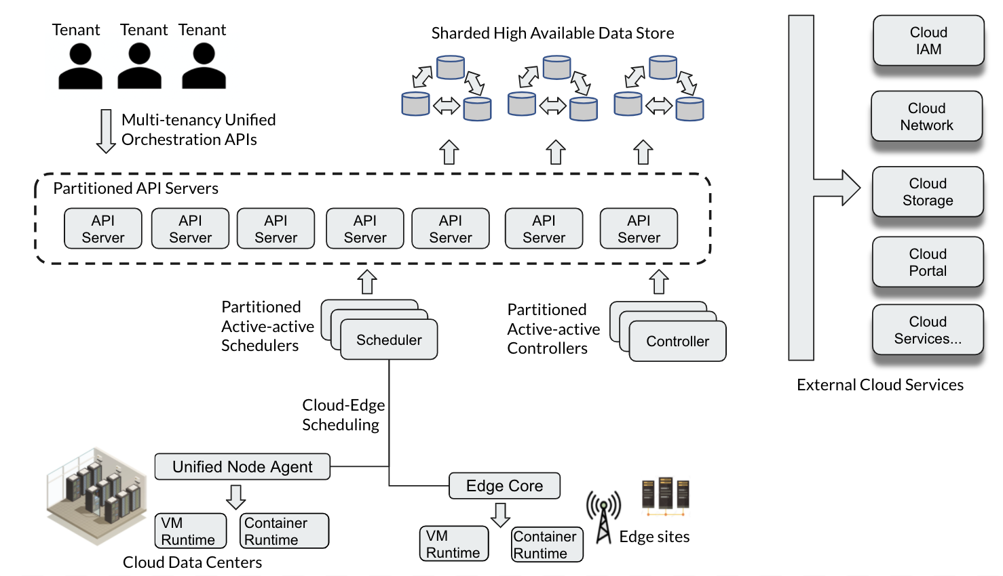
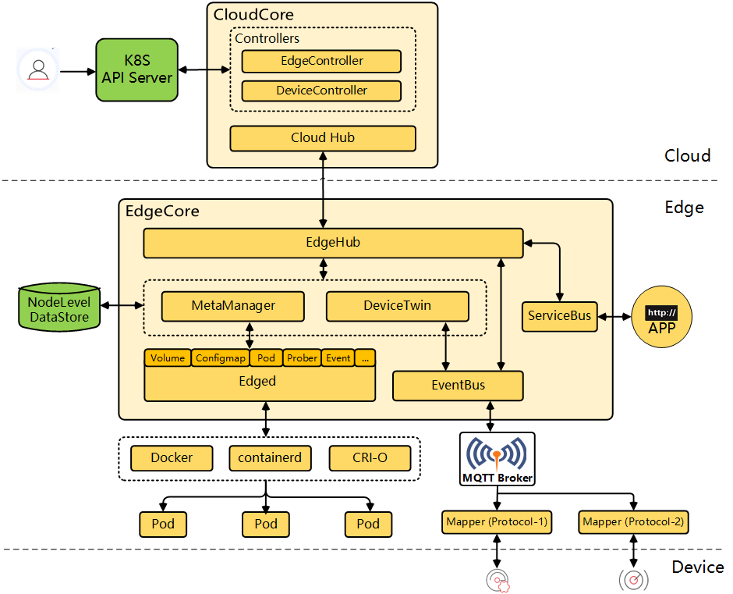
Edge Scoping Meeting
KubeEdge
Goal:
User adoption
Scalability
Gap:
Easy of use?
Application?
Performance?
Centaurus specialties:
Scalability
Multi-tenancy
Unified Runtimes
Networking
Centaurus needs:
Edge node deployment

Slide 3
Centaurus Edge
Infrastructure (PAAS)
Node management
Task scheduling
Security
Scalability
High Availability
Application
ML & AI
Data collection/pre-processing
Training in cloud
Inference on edge
App & model deployment

Slide 4
Centaurus Edge
Application
ML & AI
Data collection/pre-processing
Training in cloud
Inference on edge
App & model deployment
Infrastructure (PAAS)
Node management (KubeEdge)
Task scheduling (KubeEdge)
Security
Scalability
High Availability

Slide 5
Centaurus Edge
Application
ML & AI
Data collection/pre-processing
Training in cloud
Inference on edge
App & model deployment
Infrastructure (PAAS)
Node management (KubeEdge)
Task scheduling (KubeEdge)
Security
Scalability
High Availability

Slide 6
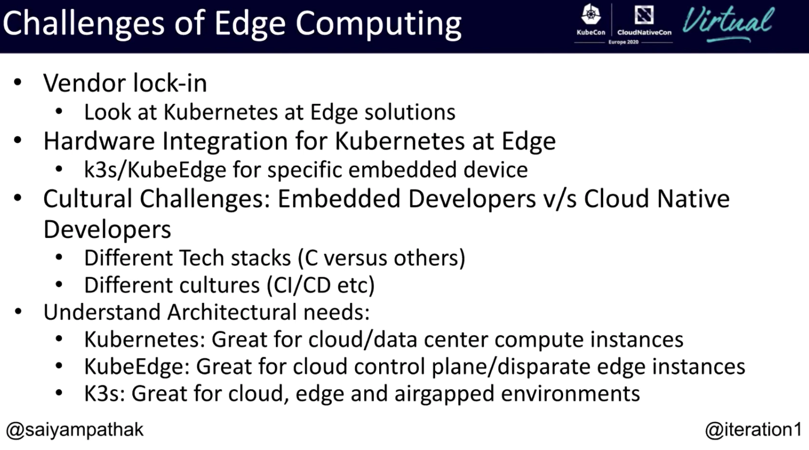
https://youtu.be/2Eqg-oKRIR8

Slide 7
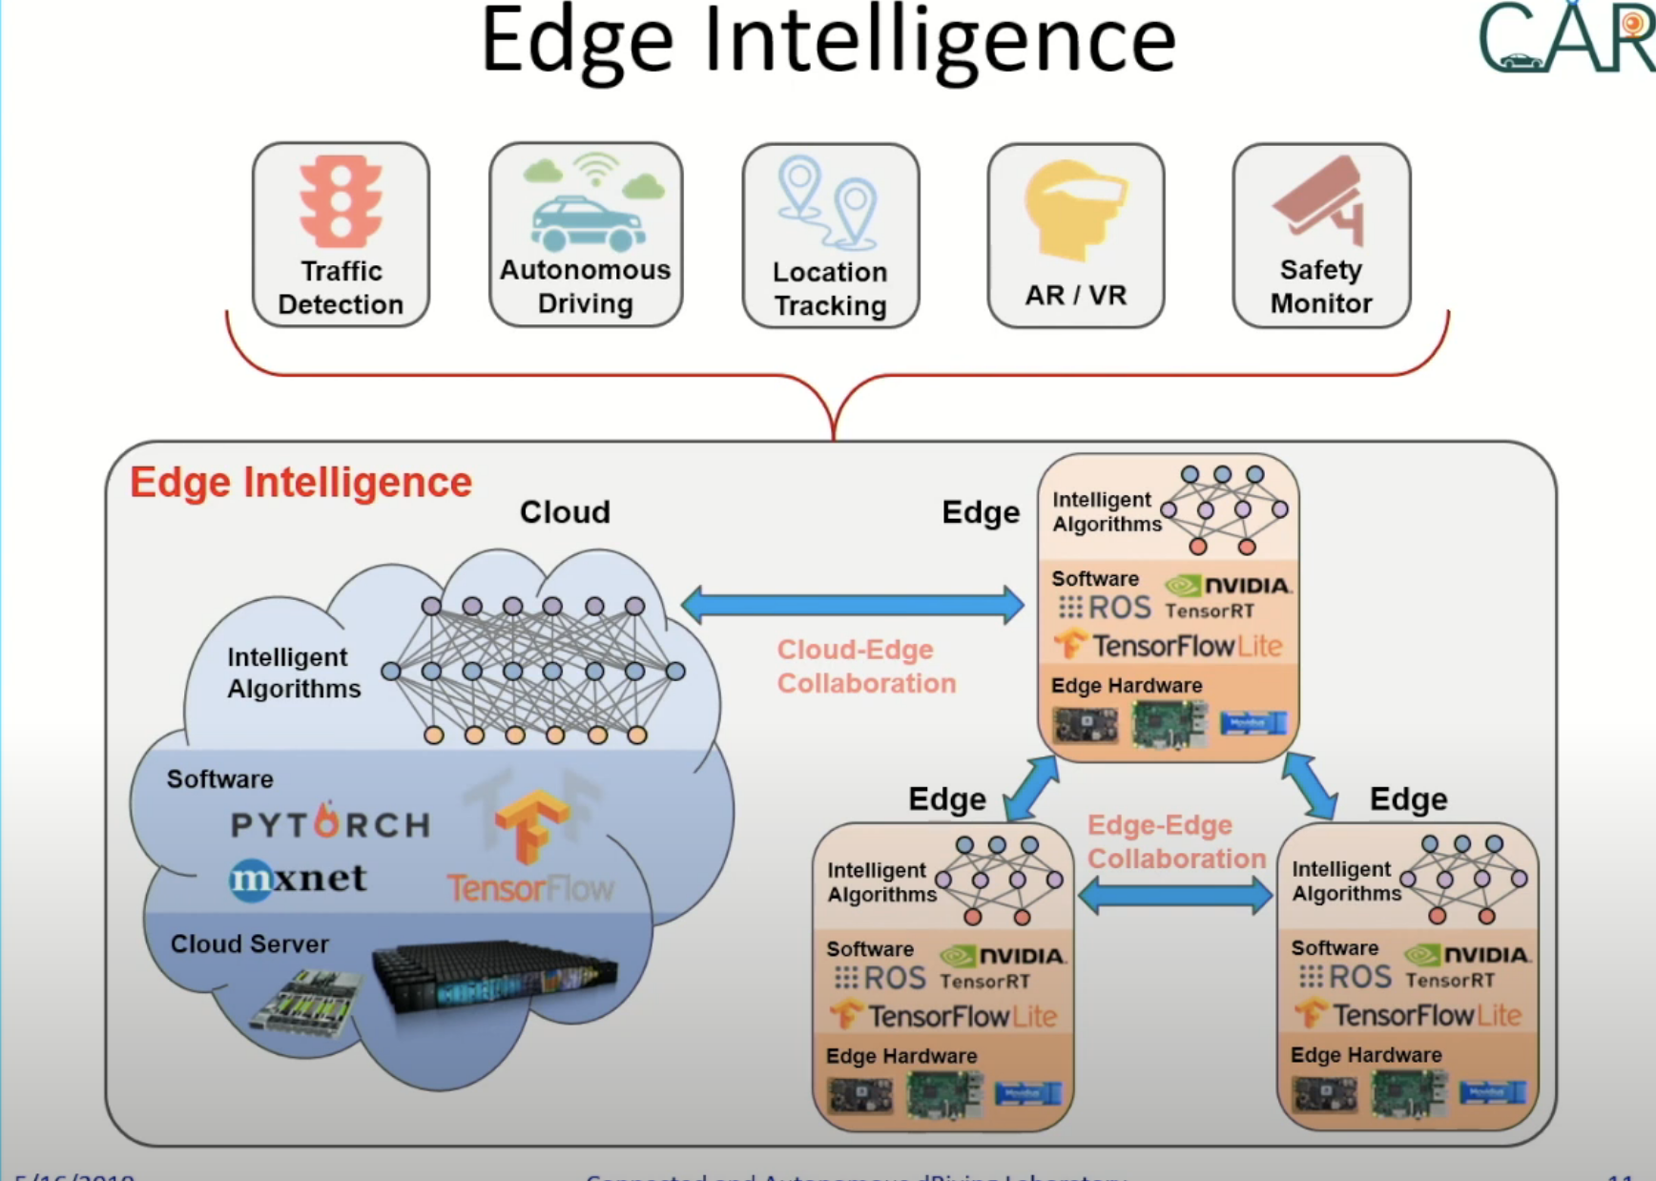
https://www.youtube.com/watch?v=SWyONtdFPpA

Slide 8
Centaurus Edge (1)
Cloud
Cloud control
Edge
Edge Devices
Cloud nodes
Edge nodes
Container
Serverless
Edge Devices
Edge nodes
Edge Devices
Storage
Edge Devices
Storage
Storage

Slide 9
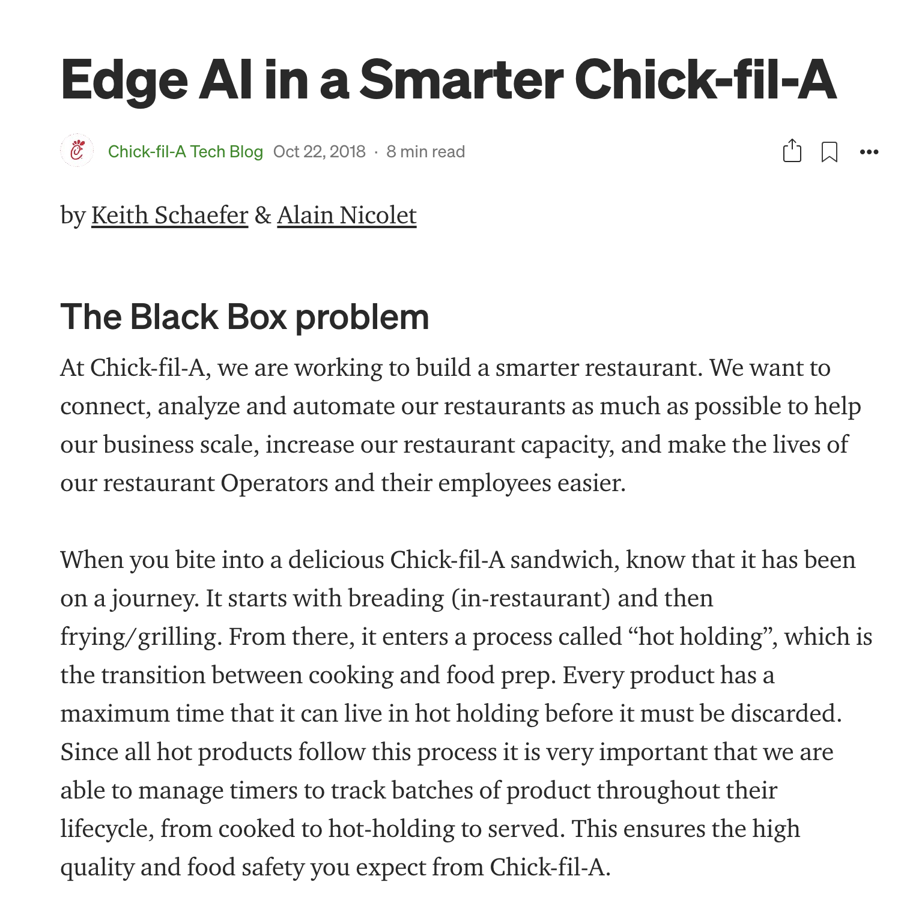
Centaurus Edge (2)
Cloud
Cloud Control Plane
Edge
Edge Devices
Cloud nodes
Edge Control Plane
Edge Devices
Edge nodes
Container
Serverless
Edge Devices
Edge nodes
Edge Devices
Storage
Storage
Storage

Slide 10
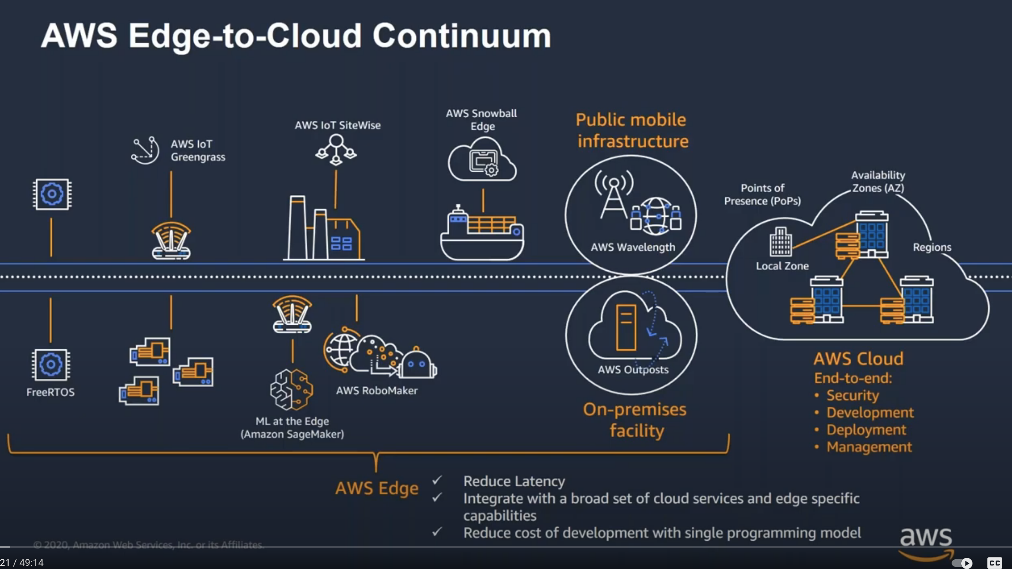
Reference Solutions
https://www.youtube.com/watch?v=hms0IkNqNJo

Slide 11
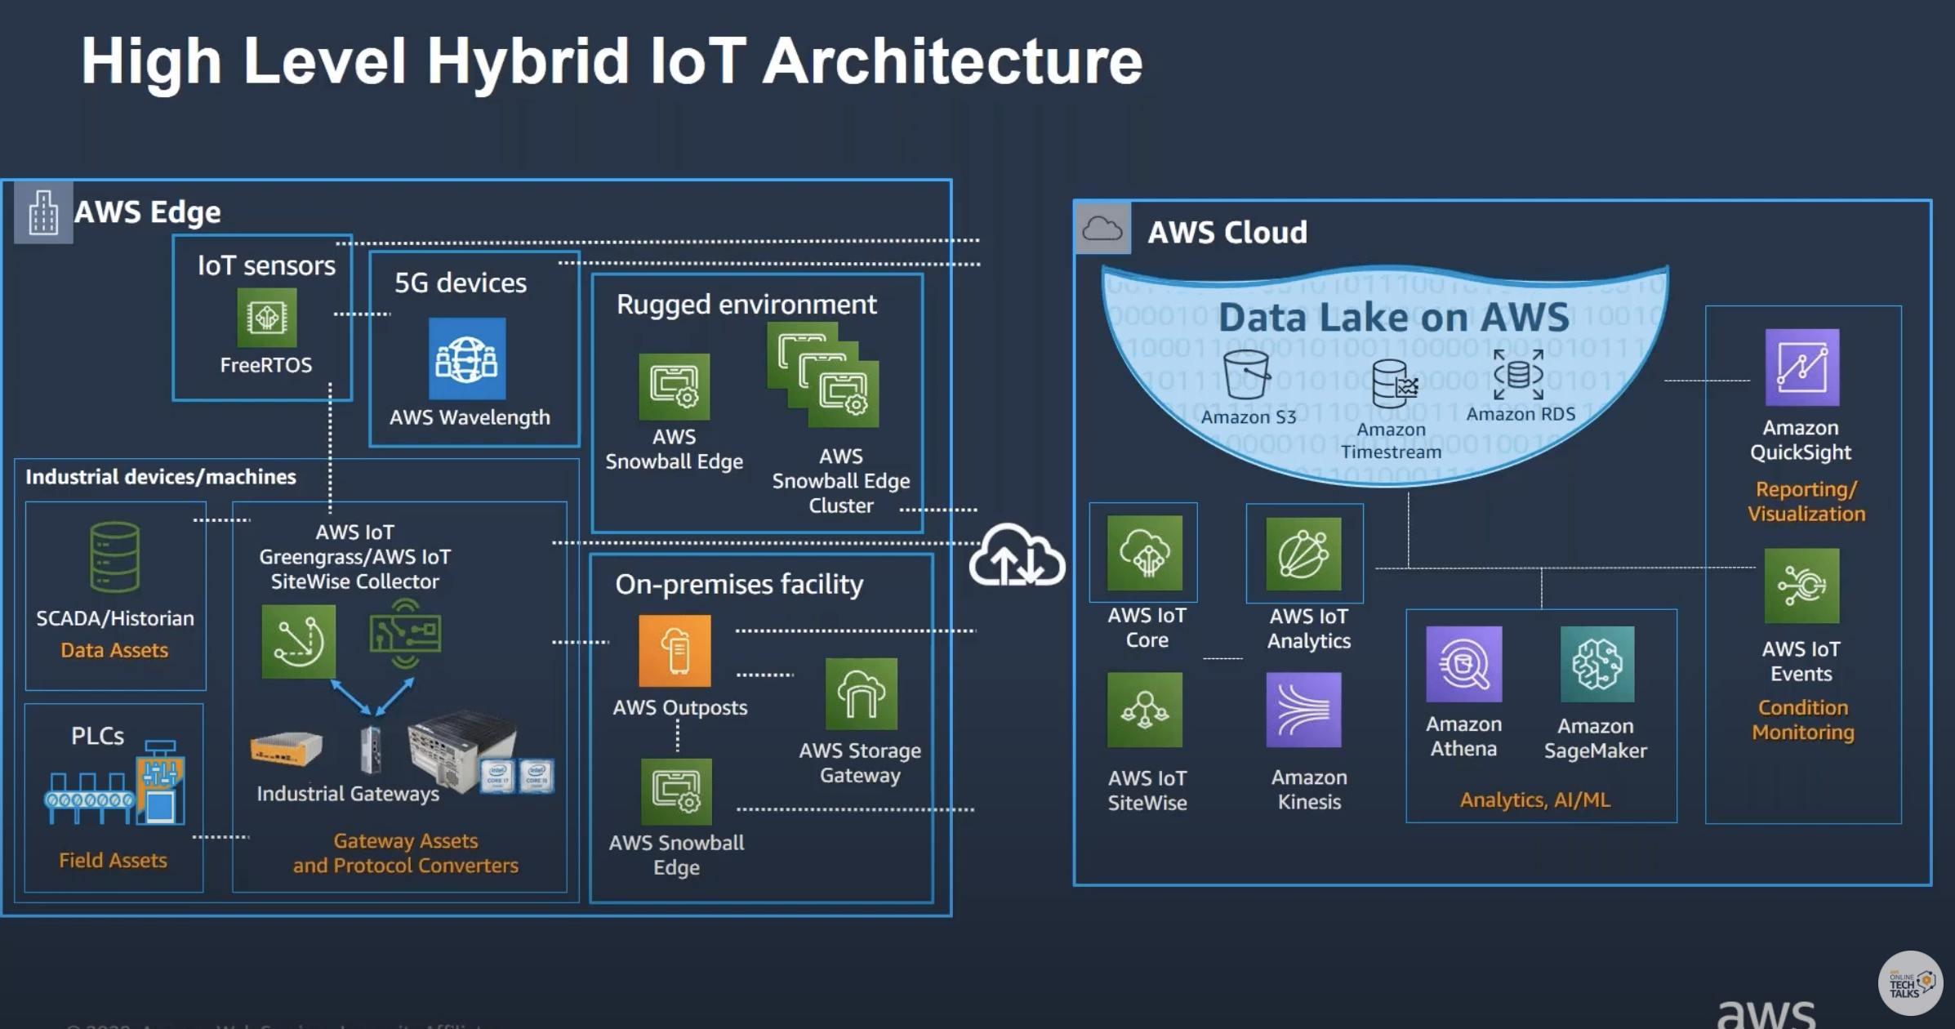
Reference Solutions
https://www.youtube.com/watch?v=jZSFQBgRnY4

Slide 12
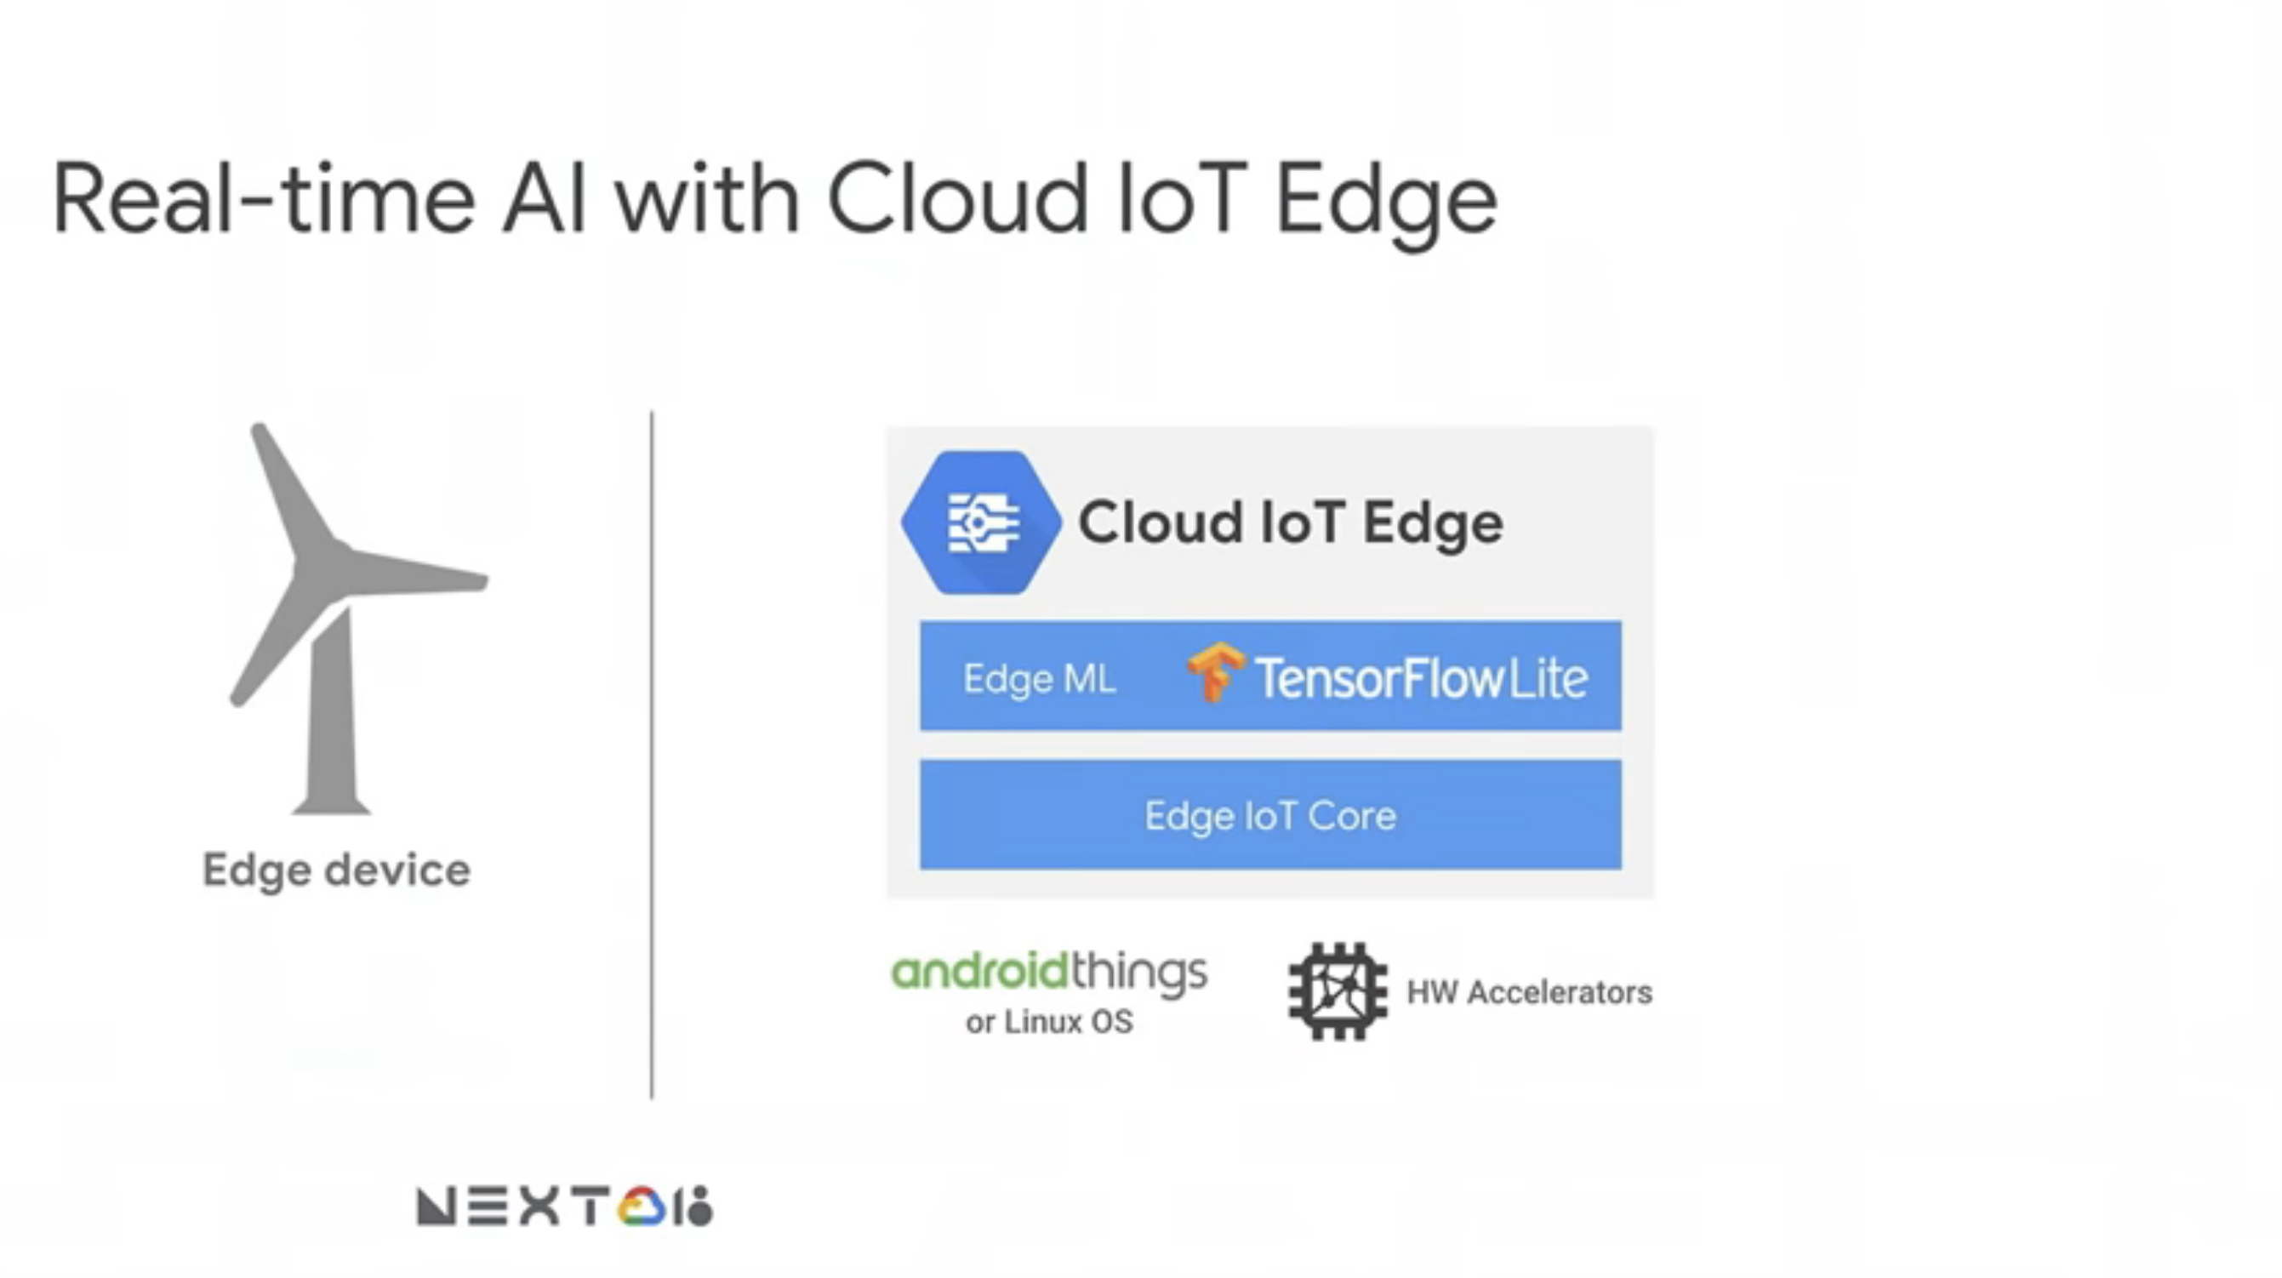
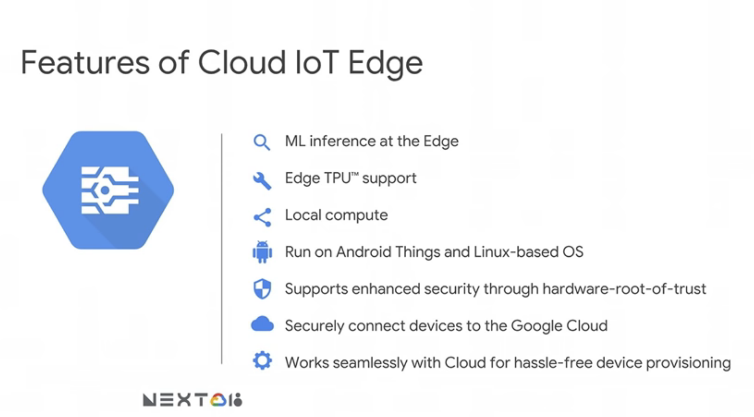
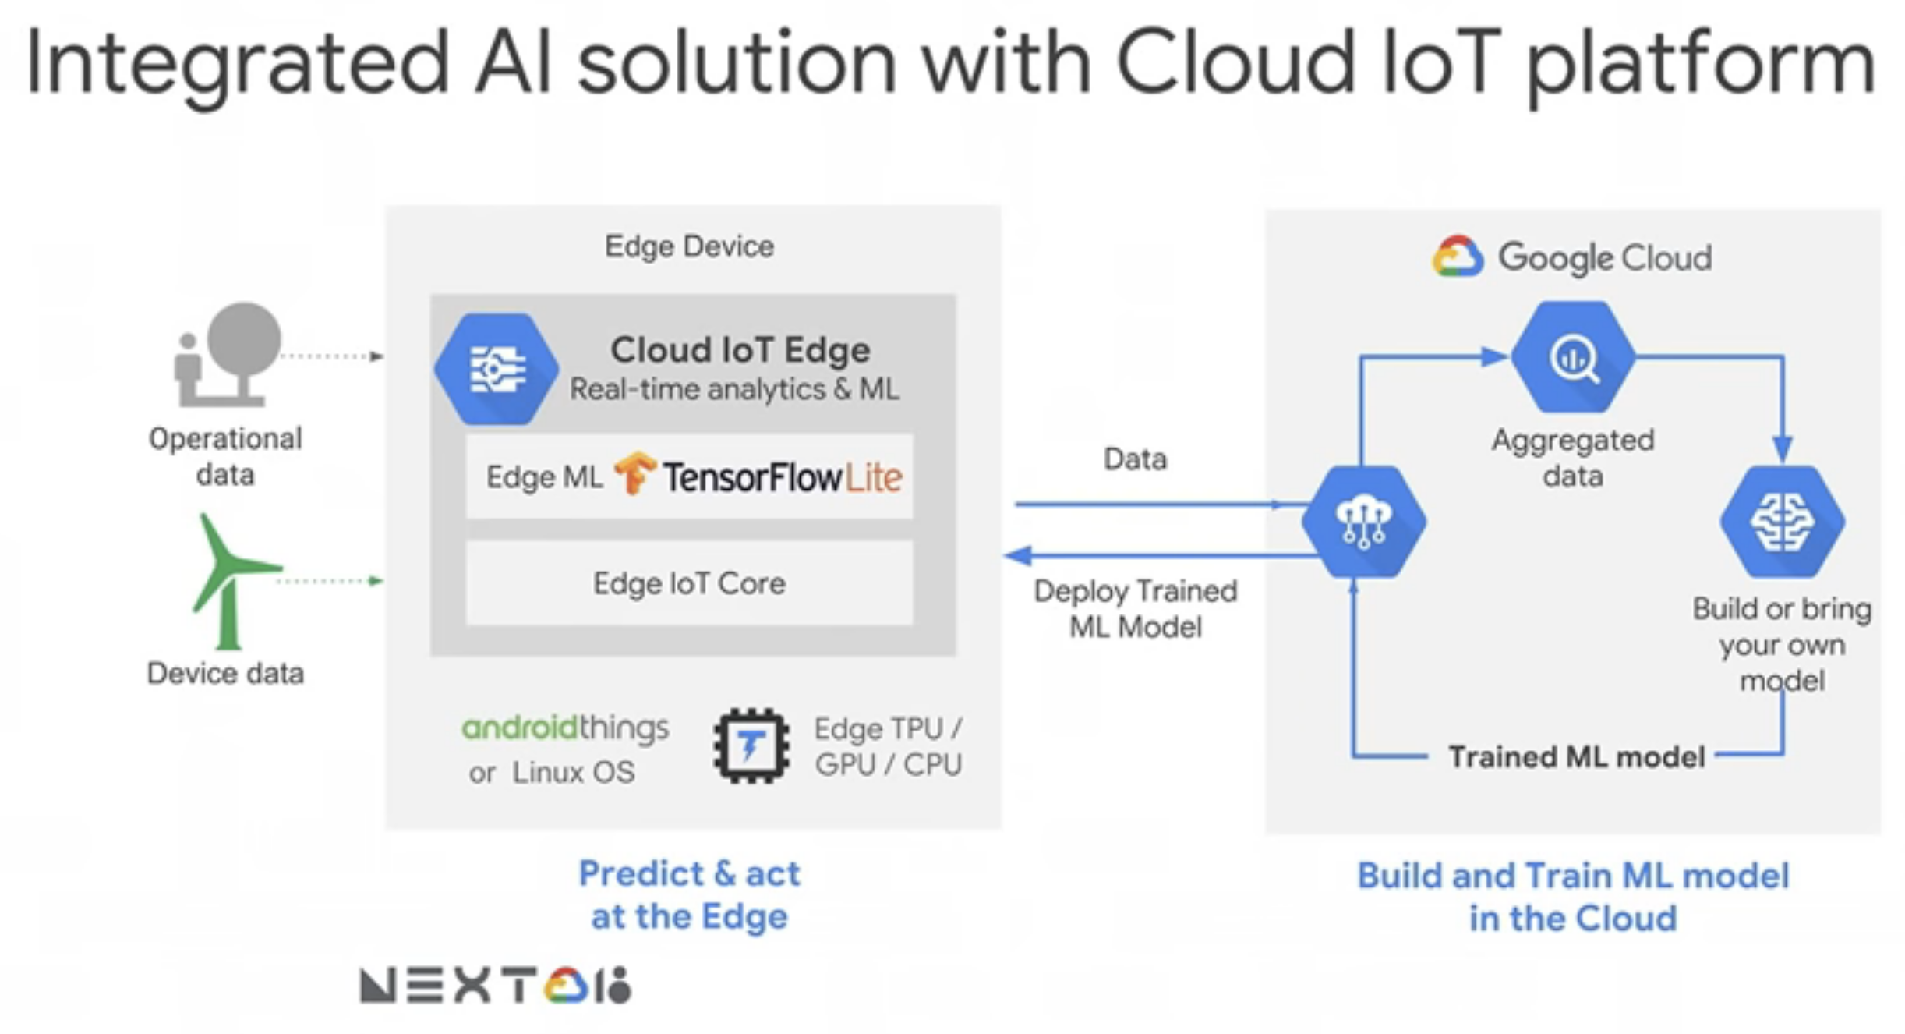
Reference Solutions

Slide 13
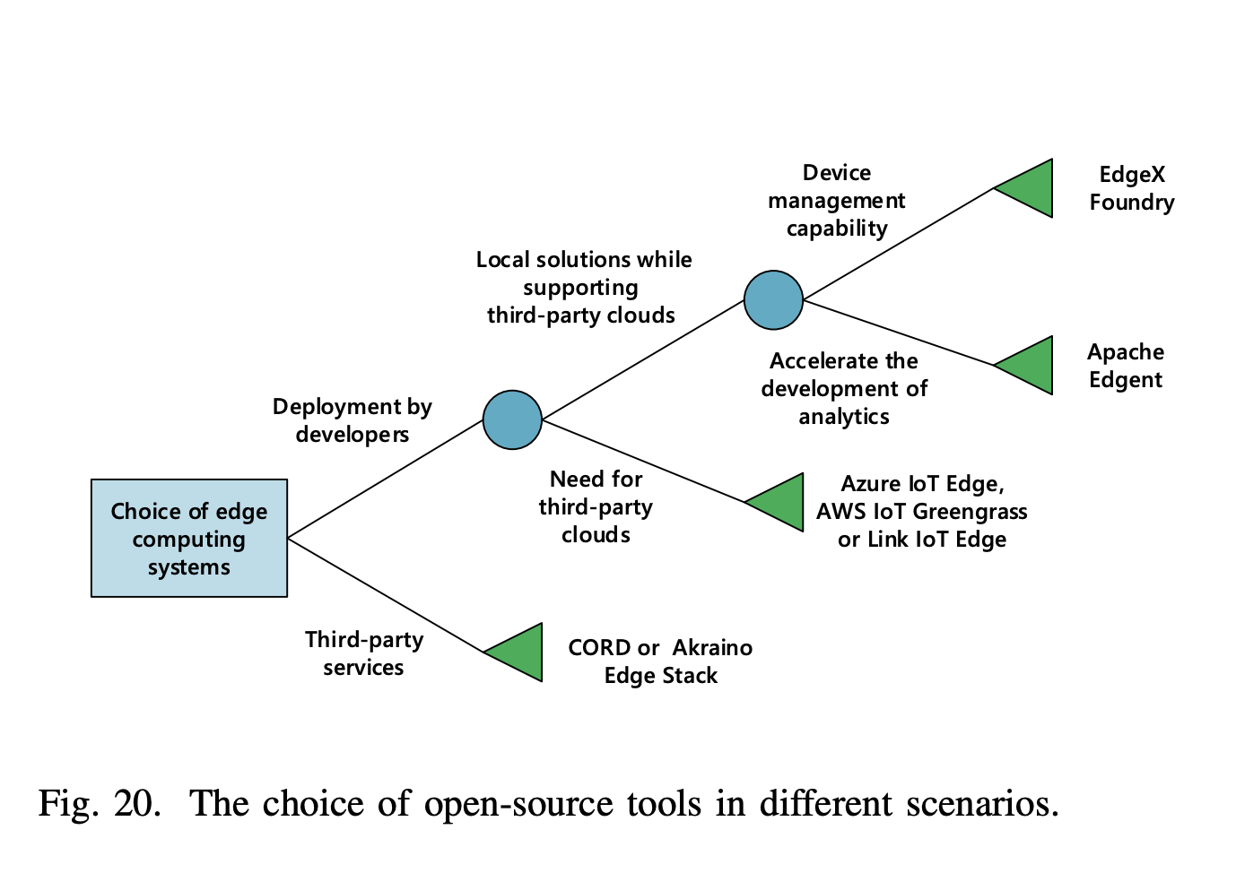
Reference Solutions
https://arxiv.org/pdf/1911.02794.pdf

Slide 14
Centaurus Edge
Application
ML & AI
Data collection/pre-processing
Training in cloud
Inference on edge
App & model deployment
Infrastructure (PAAS)
Node management (KubeEdge)
Task scheduling (KubeEdge)
Security
Scalability
High Availability

Slide 15
How can Edge Computing help mitigate Covid-19?

Slide 16
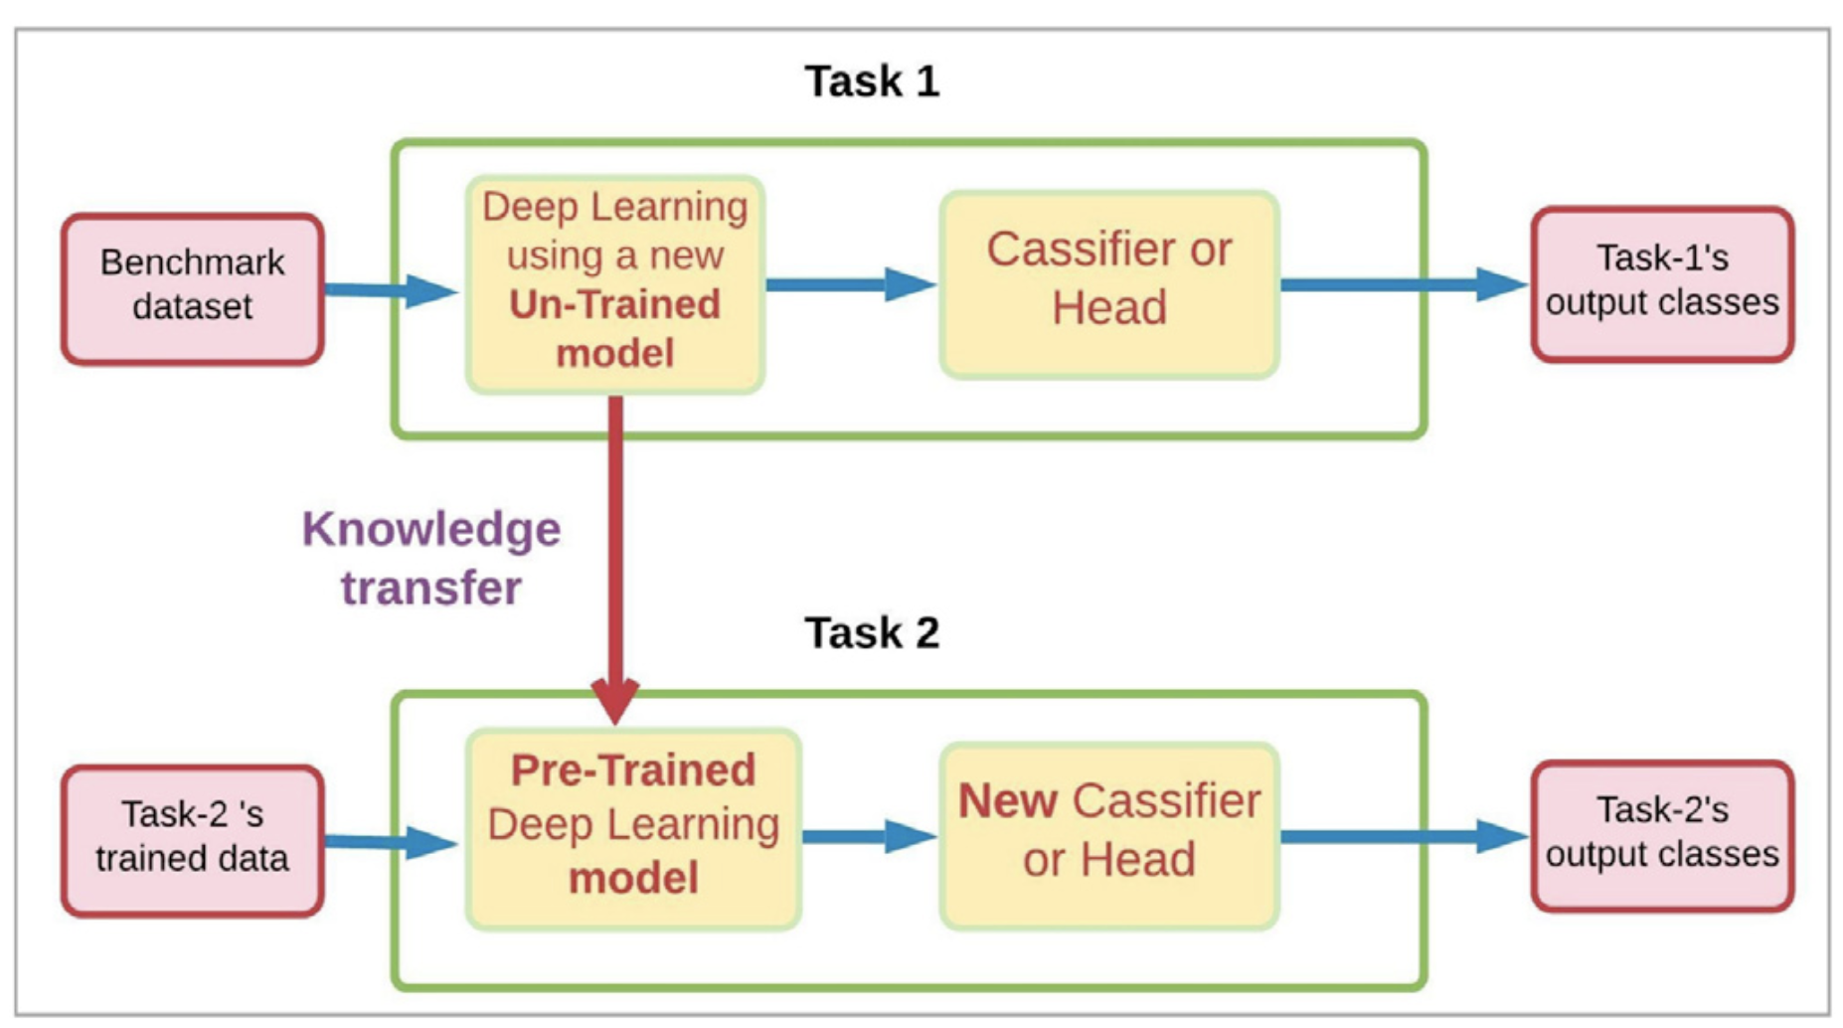
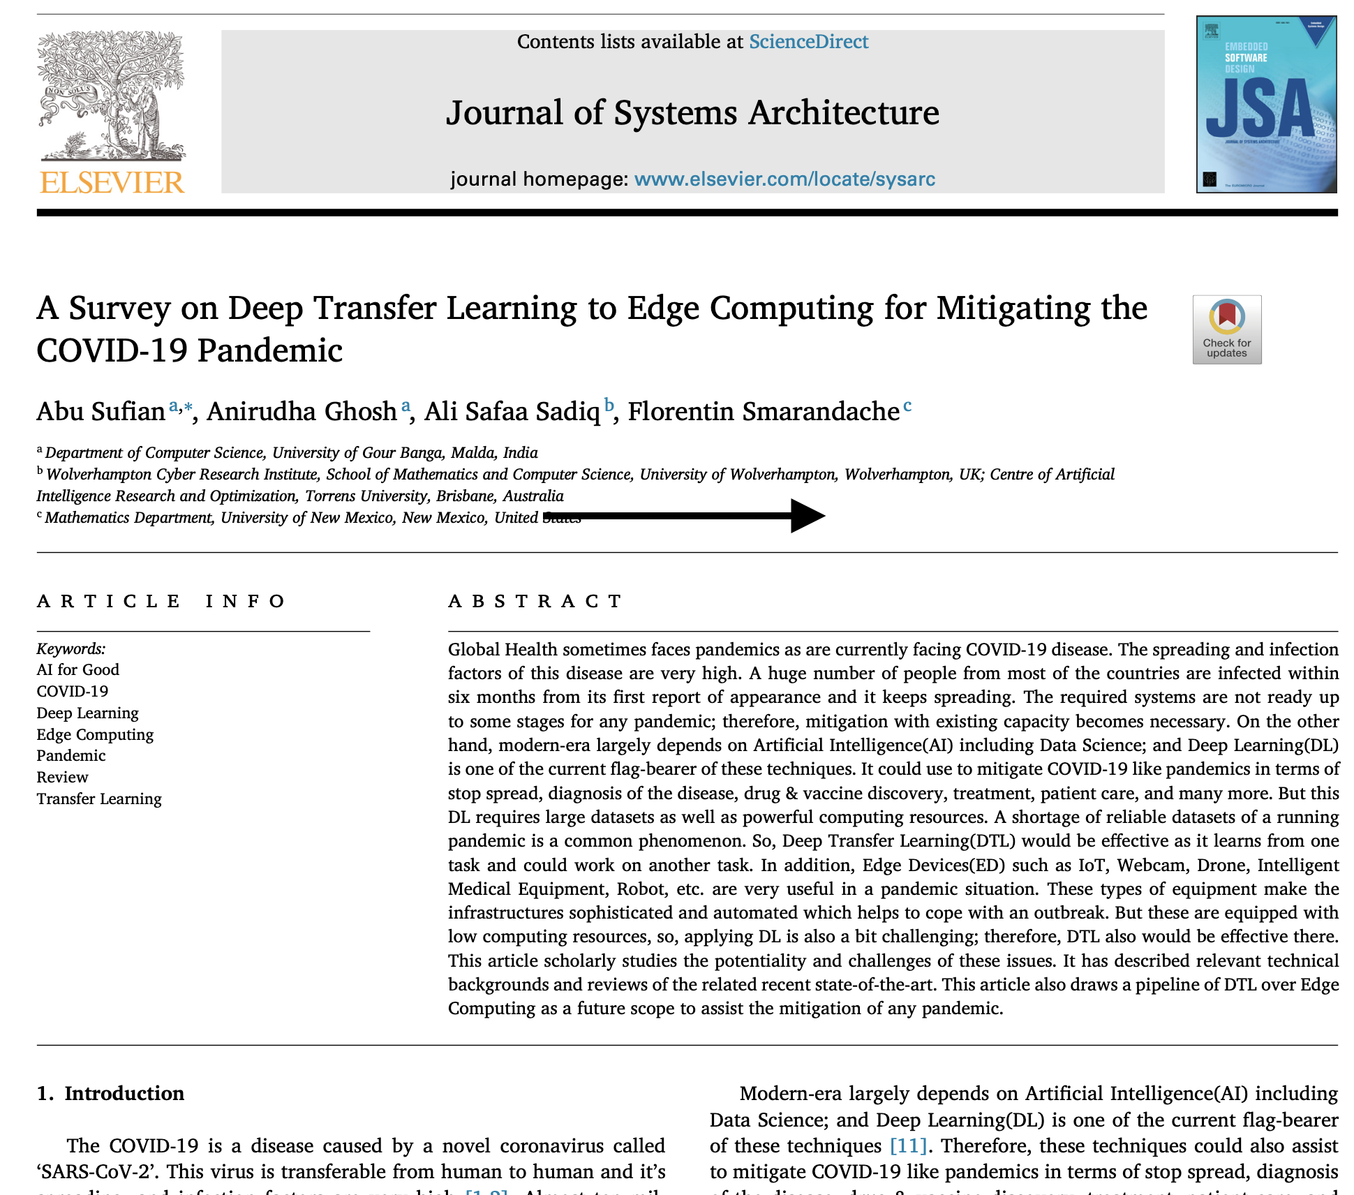
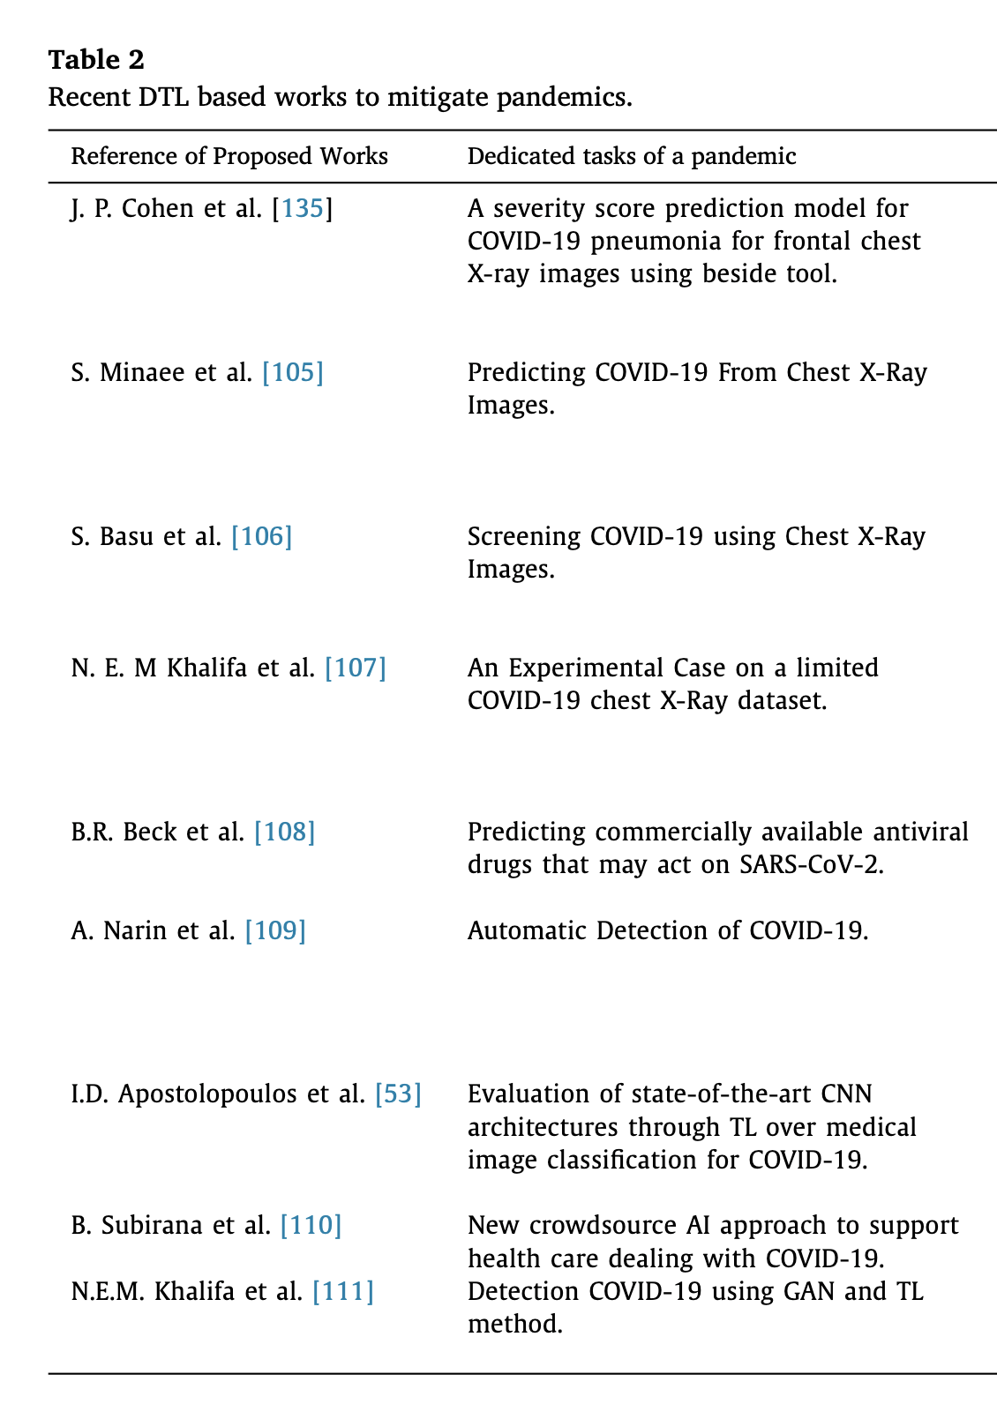
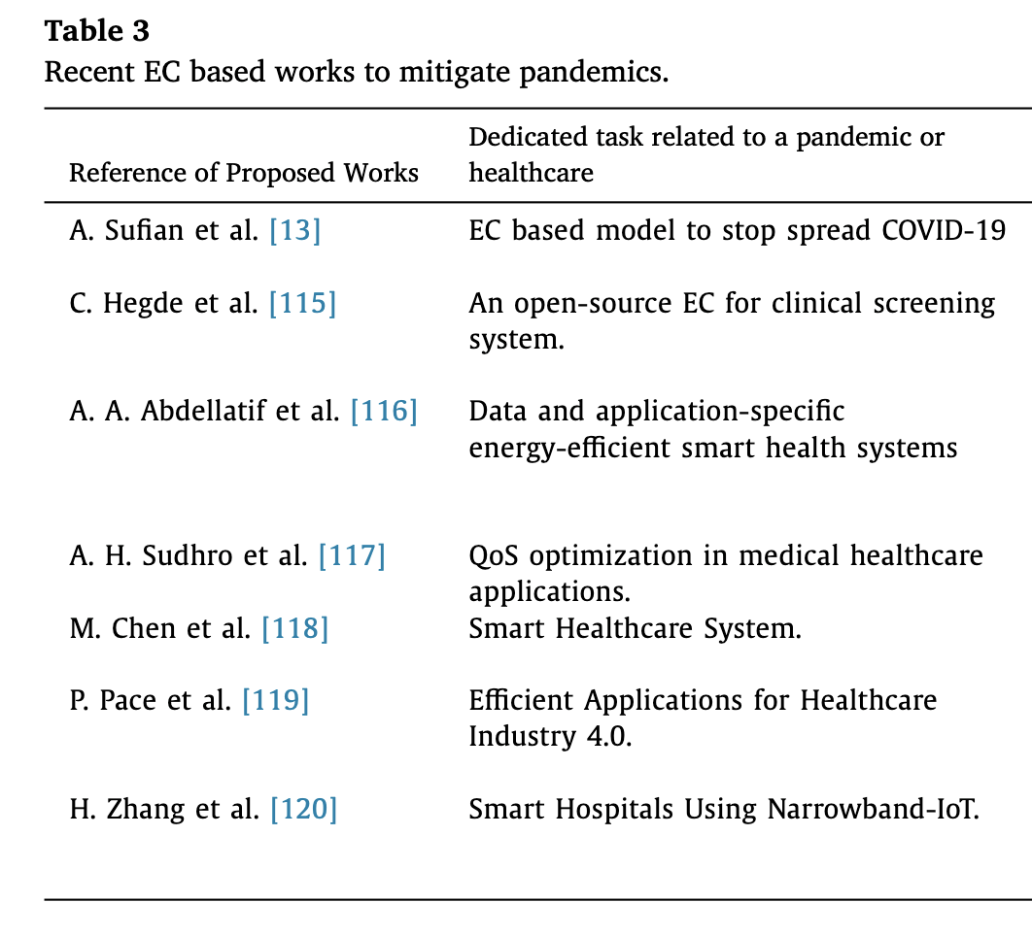
How can Edge Computing help mitigate Covid-19?

Slide 17
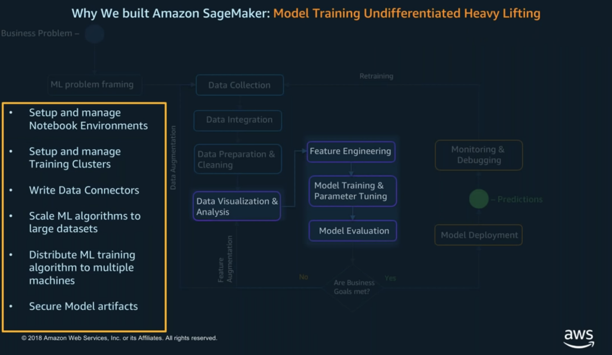

Referenced Solution

Slide 18
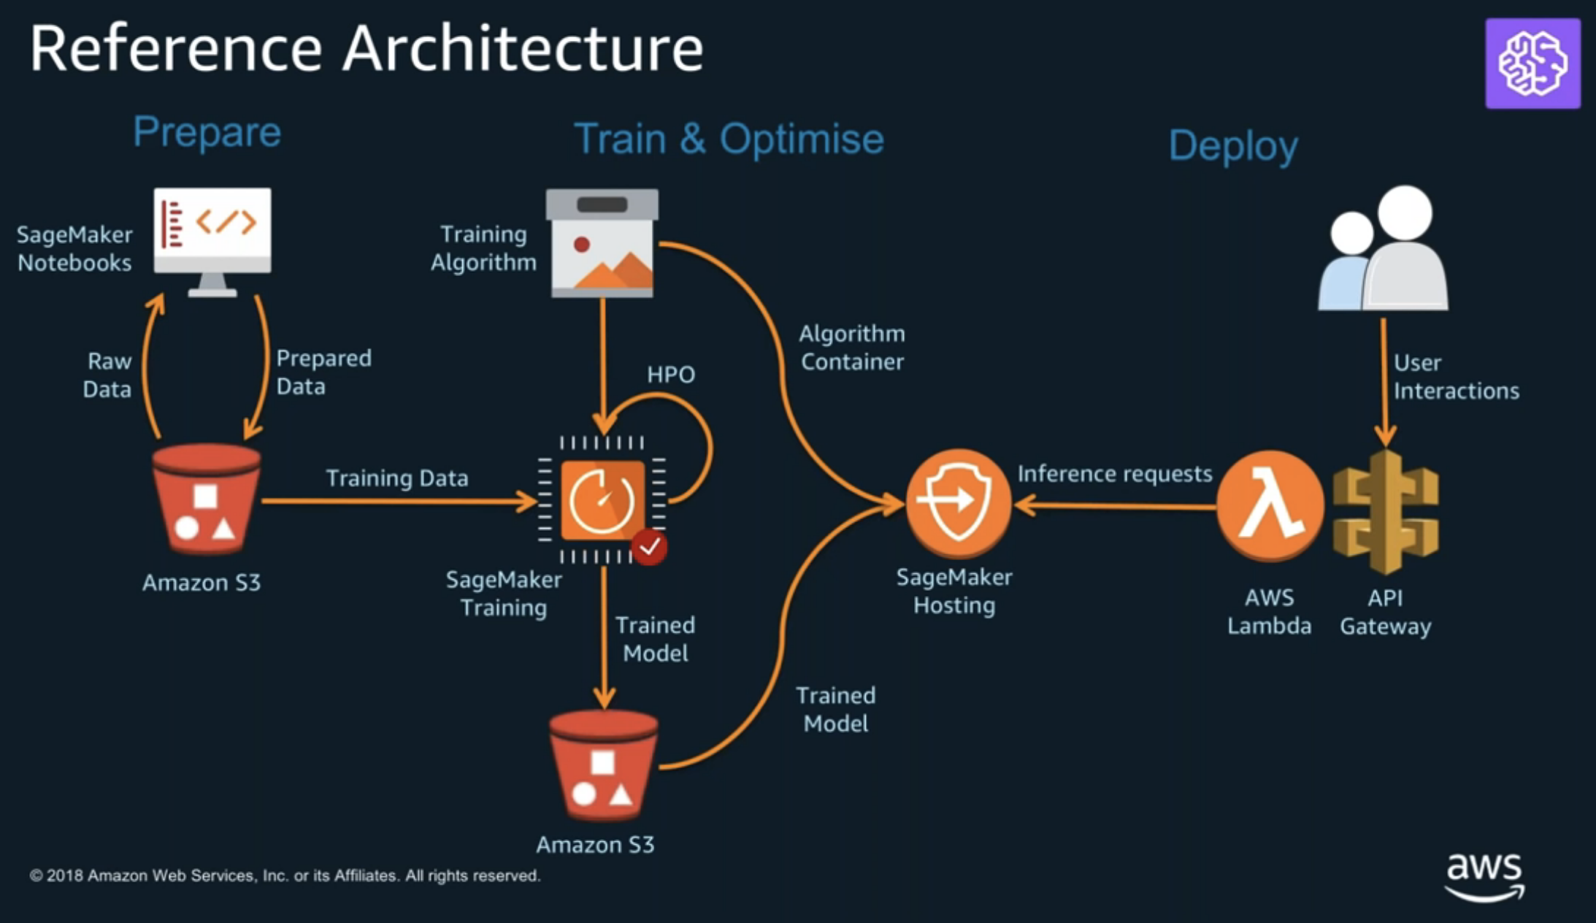
Referenced Solution

Slide 19
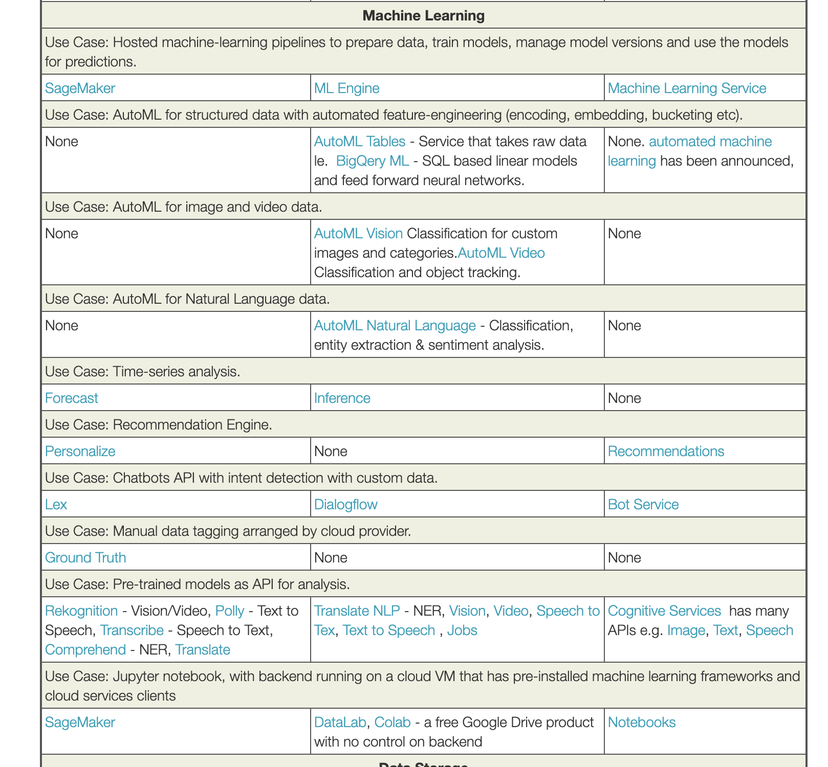
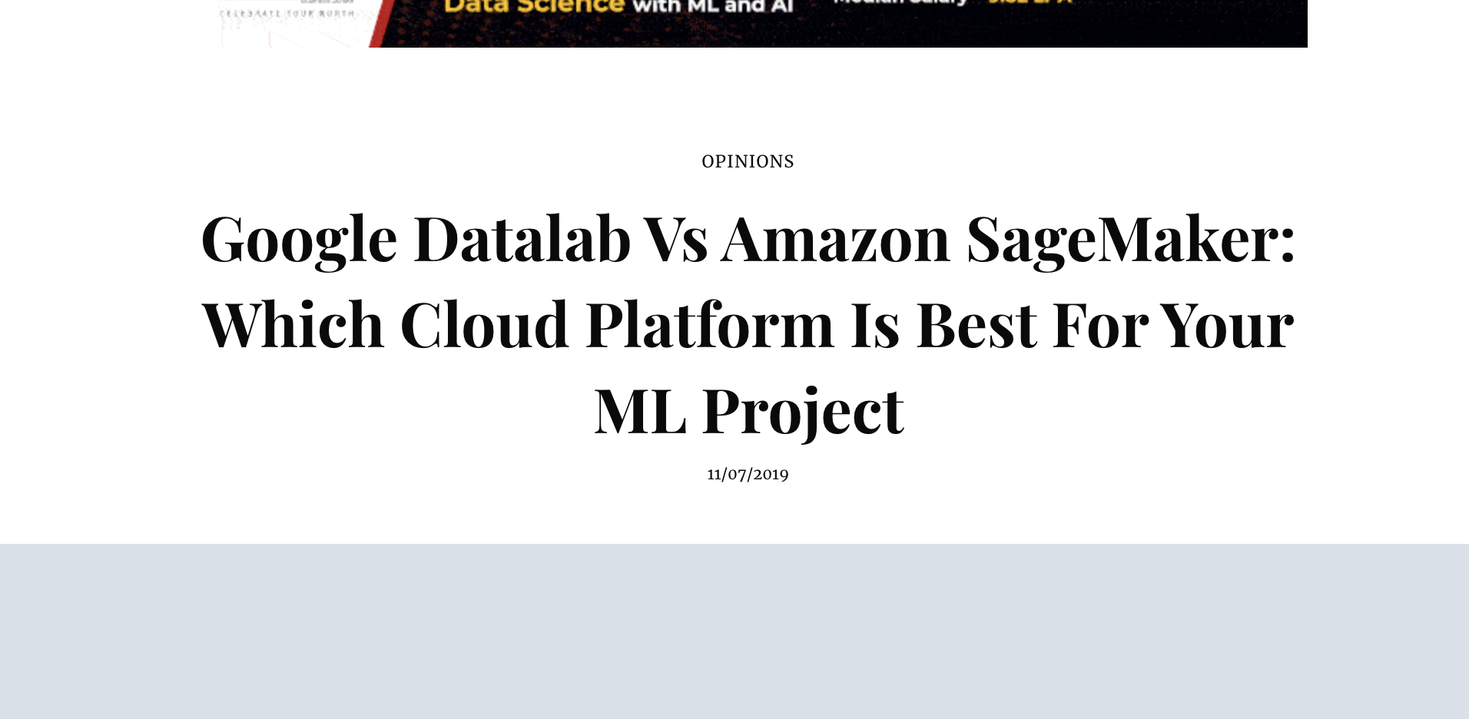
Referenced Solution
https://analyticsindiamag.com/google-datalab-vs-amazon-sagemaker-which-cloud-platform-is-best-for-your-ml-project/
https://aawasthi.blogspot.com/search?q=edge

Slide 20
Potentials
Add edge scheduling/management to Arktos
Edge cluster control planes
Extend scalability to Edge
Enhanced Security for Cloud/Edge
AI on Edge
Killer app for demo/user adoption
Model management & deployment
Ease of use

